Slide 1
CHAPTER -3
DECISION MAKING AND BRANCHING

Slide 2
INTRODUCTION
Decision making is used to see whether a particular condition has occurred or not and then direct the computer to execute certain statements accordingly.
When a program breaks the sequential flow and jumps to another part of the code, it is called branching.
When the branching is based on a particular condition, it is known as conditional branching.
If branching takes place without any decision, it is known as unconditional branching.
Control or decision making statements.
If statement
Switch statement
conditional operator statement

Slide 3
DECISION MAKING WITH IF STATEMENT :
The if statement is a powerful decision making statement and is used to control the flow of execution of statements. It is basically a two-way decision statement and is used in conjunction with an expression.
Different forms of if statement :
Simple if statement
if. . else statement
Nested if. .else statement
else if ladder

Slide 4
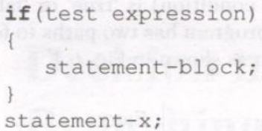
SIMPLE IFSTATEMENT
The general form of a simple if statement:
The 'statement-block' may be a single statement or a group of statements.
If the test expression is true, the statement-block will be executed; otherwise the statement-block will be skipped and the execution will jump to the statement-x.
It should be remembered that when the condition is true both the statement-block and the statement-x are executed in sequence.

Slide 5
Consider a case having two test conditions, one for weight and another for height. This is done using the compound relation
if (weight < 50 && height> 170) count = count +1;
This would have been equivalently done using two if statements as follows:
if(weight<50)
if(height>170)
count =count+l;
If the value of weight is less than 50, then the following statement is executed. Which in turn is another if statement.
This if statement tests height and if the height is greater than 170, then the count is incremented by 1

Slide 6
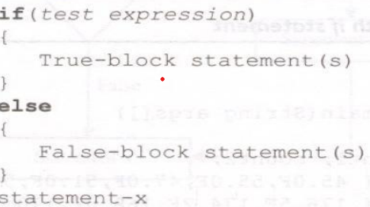
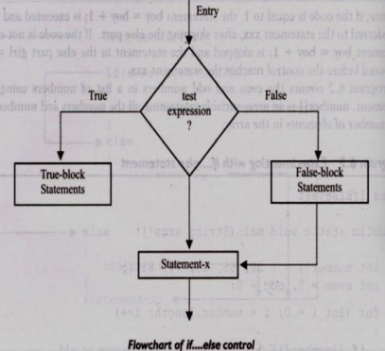
THE IF...ELSE STATEMENT
The if else statement is an extension of the simple if statement.
The general form is :
If the test expression is true, then the true-block statement(s)
are executed; otherwise, the false-block statement(s) are executed.
In either case, either true-block or false-block will be executed,
not both. In both the cases, the control is transferred
subsequently to the statement-x.
Example: if(code == 1)
{boy = boy + 1; }
else
{girl = girl + 1;} XXX;

Slide 7
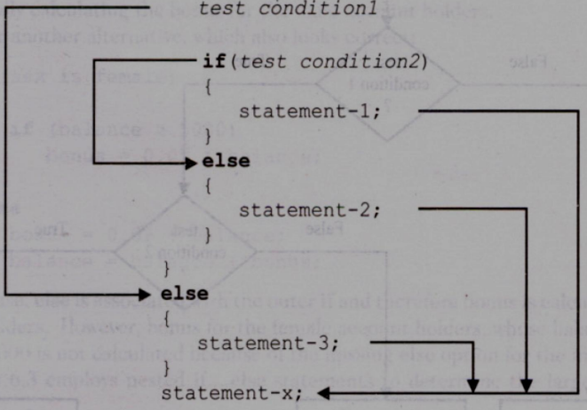
NESTING OF IF ELSESTATEMENTS :
The nested if statement represents the if block within another if block.
If the condition-1 is false, the statement-3 will be executed; otherwise it continues to perform the second test. If the condition-2 is true, the statement-1 will be evaluated; otherwise the statement-2 will be evaluated and then the control is transferred to the statement-x.

Slide 8
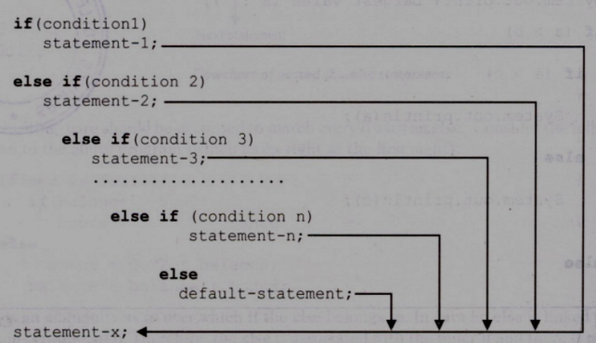
THE ELSE IF LADDER
There is another way of putting ifs together when multipath decisions are involved. A multipath decision is a chain of ifs in which the statement associated with each else is an if.
The construct is known as the else if ladder. The conditions are evaluated from the top (of the ladder), downwards. As soon as the true condition is found, the statement associated with it is executed and the control is transferred to the .when all the n conditions become false, then the final else containing the default-statement will be executed.

Slide 9
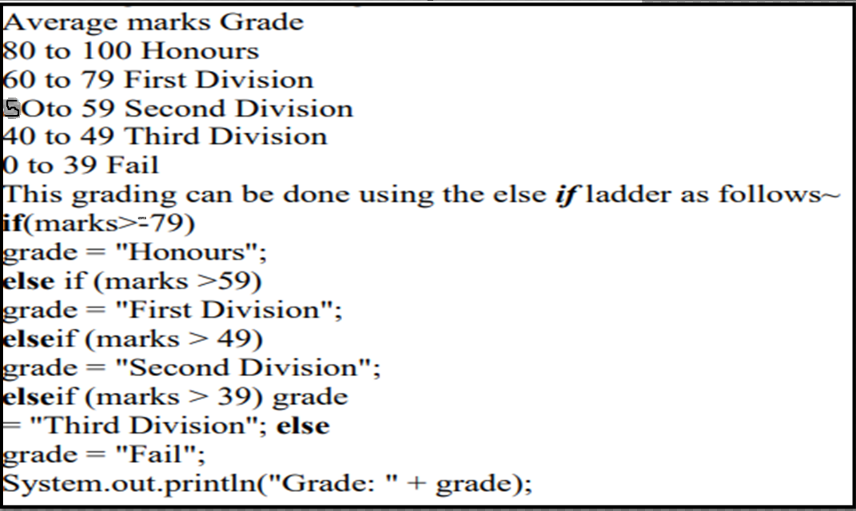
Example of grading the students in an academic institution.
The grading is done according to the following rules:

Slide 10
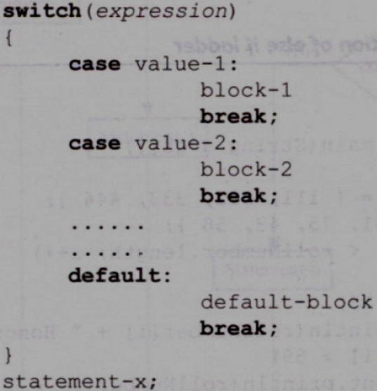
THE SWITCH STATEMENT :
The switch statement tests the value of a given variable (or expression) against a list of case values and when a match is found, a block of statements associated with that case is executed.
General Form:

Slide 11
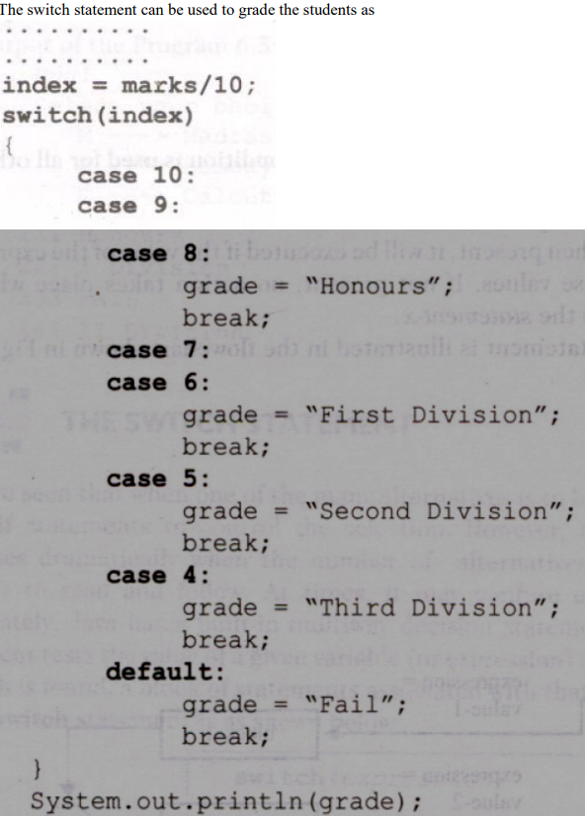
Example:

Slide 12
THE ?: OPERATOR
The Java language has an unusual operator, useful for making two-way decisions. This operator is a combination of ? and : and takes three operands. This operator is popularly known as the conditional operator.
The general form:
The conditional expression is evaluated first. If the result is true, expression is evaluated and is returned as the value of the conditional expression. Otherwise, expression 2 is evaluated and its value is returned.

Slide 13
Decision making and Looping
The process of repeatedly executing a block of statements is known as looping. If a loop continues forever, it is called an infinite loop.
A control structure may be classified either as the entry controlled loop or as exit-controlled loop.
In the entry-controlled loop, the control conditions are tested before the start of the loop execution.
In an exit-controlled loop, the test is performed at the end of the body of the loop and therefore the body is executed unconditionally for the first time.
The Java language provides for three constructs for performing loop operations. They are:
1 The while statement
2 The do statement
3 The for statement

Slide 14
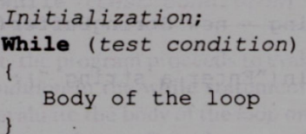
While loop :
The simplest of all the looping structures in Java is the while statement.
The basic format of the while statement is :
The while is an entry-controlled loop statement.
The test condition is evaluated and if the condition is true, then the body of the loop is executed.
After execution of the body, the test condition is once again evaluated and if it is true, the body is executed once again.
This process of repeated execution of the body continues until the test condition finally becomes false and the control is transferred out of the 1oop. On exit, the program continues with the statement immediately after the body of the loop.

Slide 15
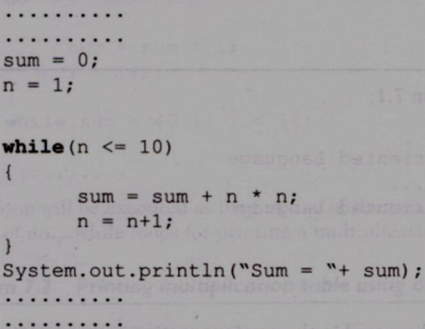
Example:-
Do-while:
The Do-while is an exit-controlled loop statement.
The while loop construct makes a test condition before the loop is executed.
Therefore, the body of the loop may not be executed at all if the condition is not satisfied at the very first attempt.
On some occasions it might be necessary to execute the body of the loop before the test is performed. Such situations can be handled with the help of the do statement.

Slide 16
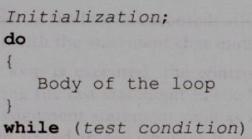
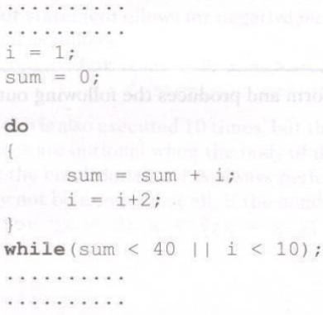
Syntax:
Example:-

Slide 17

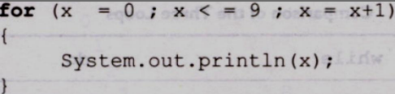
THE FOR STATEMENT:
The for loop is another entry-controlled loop that provides a more concise loop control structure.
The general form of the for loop
Initialization of the control variables is done first, using assignment statements such as i = 1 and count = o. The variables i and count are known as loop-control variables.
2. The value of the control variable is tested using the test condition.
3. The control variable is incremented using an assignment statement such as i = i+ 1 and the new value of the control variable is again tested to see whether it satisfies the loop condition
Example:

Slide 18
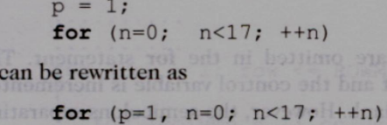
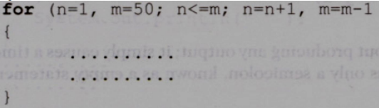
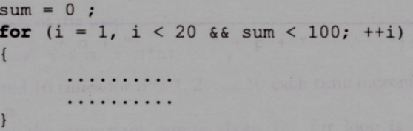
Additional Features of for Loop:
The for loop has several capabilities that are not found in other loop constructs.
For example, more than one variable can be initialized at a time in the for statement. The statements initialization section has two parts p = 1 and n = 1 separated by a comma. Like the initialization section, the increment section may also have more than one part.

Slide 19
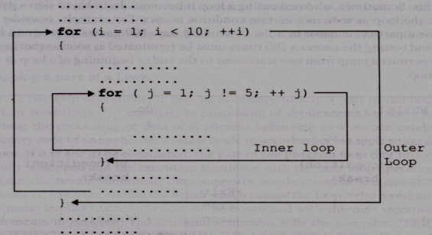
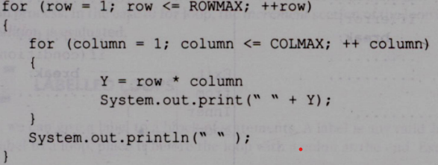
Nesting of for Loops
Nesting of loops, that is, one for statement within another for statement is allowed in Java.
Example:

Slide 20
Jumps in Loop:
The jumping statements are the control statements which transfer the program execution control to a specific statements.
Java has three types of jumping statements they are break, continue, and return.
Java Break Statement:
We can use break statement in the following cases.
Inside the switch case to come out of the switch block.
Within the loops to break the loop execution based on some condition.
The break cannot be used outside the loops and switch statement.
Java Continue Statement:
This statement is used only within looping statements.
When the continue statement is encountered, then it skip the current iteration and the next iteration starts.

Slide 21
Java Return Jumping Statement
The return statement is mainly used in methods in order to terminate a method in between and return back to the caller method. It is an optional statement.
Return statement may or may not return parameters to the caller method.
LABELLED LOOPS
A label is a valid variable name that denotes the name of the loop to where the control of execution should jump. To label a loop, place the label before the loop with a colon at the end. Therefore, a loop with the label is called a labeled loop.
We can also use labels with continue and break statements.

